Slide 1

Corporate Profile

Slide 2
Fast Facts
1999
400+
5000+
15+
Established
Employees
Happy Customers
Locations
10
27
02
₹1.4
Own Brands
Alliance
Brands
Manufacturing Facilities
Billion Annual Turnover

Slide 3
Vision
Mission
Values
To build a global organization that offers efficient and technologically ahead products, nurtures smart and ethically sound people.
To consistently deliver extraordinary products and superior value to our customers to enable them in serve their customers better.
Pioneer
Client Value Creation
Innovation
Integrity
Teamwork
Trust in People

Slide 4
Leading Manufacturer and
One Stop Solutions Provider for Printing and Packaging Industry Globally

Slide 5
Abundant Product Portfolio
OFFSET
DIGITAL PRINTING
Conventional CtP Systems
Thermal CtP Systems
Violet CtP Systems
Flexo CtP Systems
Gravure Cylinder Engravers
Computer-to-Screen (CtS) Systems
Offset Plate Processors
Flexo Finishing Units
Sheetfed Offset Press
Post-Press Solutions
Digital Printing Press
DIGITAL ENHANCEMENT
Digital Print Enhancement Press
DIGITAL PRINT FINISHING
Digital Cutting and Creasing
Digital Laminators
Laser Cutting and Engraving Systems
Specialized Lamination Films
Process Metallic Color System

Slide 6
Abundant Product Portfolio
WIDE FORMAT PRINTING
3D PRINTING & SCANNING
Super Size 3D Printers
Digital Solvent Printers
Eco Solvent Printers
UV Flatbed/Hybrid Printers
UV LED RTR Printers
Desktop, Professional and Production 3D Printers
3D Scanners
3D Printing Services
ENGINEERING SYSTEMS
Overhead Scanners
Large Format Scanners
Large Format Laser Multifunction Systems
Large Format Inkjet Printers
Multifunction Systems
TEXTILE PRINTING
Sublimation Printers
Direct to Fabric Printers

Slide 7
Abundant Product Portfolio
INKJET PRODUCTS & SOLUTIONS
LABELS & PACKAGING
Inkjet Imprinting Systems - Monochrome
Full Color Digital Inkjet Systems
Slitter Rewinder and Inspection Systems
Inkjet Web Press – Monochrome
Inkjet MICR Printing
Intermittent Offset Press
CI Letter Press
Digital Label Press
Label Finishing and Accessories

Slide 8
Segments We Serve
OFFSET PRINTERS
Pre-Press, Press, Post-Press & Enhancement Solutions
DIGITAL PRINTERS
Monochrome Inkjet Press, Digital Color Press, Print Enhancement and Print Finishing Solutions
SCREEN PRINTERS
Computer to Screen (CtS) Systems
SIGNAGE & INDUSTRIAL PRINTERS
PACKAGING PRINTERS
TEXTILE PRINTERS
Imprint Solution, Flexo CtP, Gravure Engraver
Sublimation and Direct to Fabric Printing Solution
UV flatbed & Roll to Roll printers, Solvent and Eco solvent Printers, Super size 3D printers
MANUFACTURING, MEDICAL AND DENTAL
ENGINEERING INDUSTRY
Wide Format Printers, Scanners & Multi-function Systems
Desktop, Professional, Production 3D Printers and Scanners

Slide 9










Our Brands building brands customers can trust
Laser Cutting and Engraving Systems
Print Finishing Solutions
Paper Cutting Solutions
Digital UV and Varnish Systems
Hydraulic Paper Cutters
Gravure Engravers
Industrial Inkjet Systems and Brand
Protection Solutions
3D Printing Services
Signage and Industrial Printing Solutions
Specialized BOPP Lamination Films

Slide 10















Our Alliances partnering with the best
United States
Europe
Europe
Germany
Singapore
Denmark
United States
China
Spain
China
USA
Taiwan
Korea
Israel
China

Slide 11













Our Alliances partnering with the best
China
France
Germany
Japan
USA
Taiwan
China
Israel
Japan
Italy
Israel
China
Taiwan
Germany

Slide 12

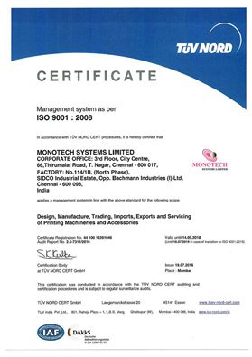
Quality Policy
“We are committed to achieve customer satisfaction by providing quality products and services and continuously improve effectiveness through systematic quality processes”

Slide 13
Our Growth Priorities
COMPETITIVE EDGE THROUGH INNOVATION
WINNING WITH PEOPLE
Organization with diverse talent capable to meet our growth aspirations
Performance culture which reflects our values
Leverage our knowledge resource for competitive advantage
Innovation is Life – Think new is a continuous process
Appeal to more customers across needs and budget
Win
Share
Grow
WINNING IN THE MARKETPLACE
WINNING THROUGH CONTINUOUS IMPROVEMENT
Lead market development
Win with winning customers
One stop solutions provider
Lean, responsive and customer friendly processes
Agile, flexible and learning organization

Slide 14

Our Presence
15+
Locations across the nation
EAST
WEST
NORTH
SOUTH
KOLKATA
BHUBANESHWAR
GUWAHATI
MUMBAI
AHMEDABAD
PUNE
INDORE
NAGPUR
NEW DELHI
GURUGRAM
LUDHIANA
JAIPUR
CHENNAI
BENGALURU
HYDERABAD
KOCHI

Slide 15

Remarkable Achievements
Market Leaders in India
Pre-Press
Digital Printing (2013 to 2015)
Digital Print Enhancement
Inkjet Plotters – OCE
Inkjet Imprint Solutions

Slide 16



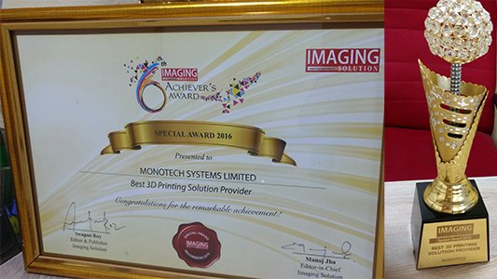
Recognitions
Awards
Outstanding Performance Award by GMP, Korea
Best 3D Solutions Provider by Imaging Solution, India
Partner of the Year 2014 by Konica Minolta
Partner of the Year APAC for 2016 & 2017 by Scodix, Israel

Slide 17
Constant product innovation
Flawless integration
Extending Value to Customers
World class products & solutions
Committed after sales support
Single window solution
Assuring customer delight

Slide 18
Monotech Systems Limited
3rd Floor, City Centre, #66 Thirumalai Pillai Road, T. Nagar, Chennai – 600 017, India
Tel: +91 44 2815 7928/7894/7933
Fax: +91 44 2815 7973
email: info@monotech.in
www.monotech.in

